Slide 1
10 Steps for Designing Education As Part of Guideline Implementation
Evidenced-Based Guidelines
Education Toolkit

Slide 2
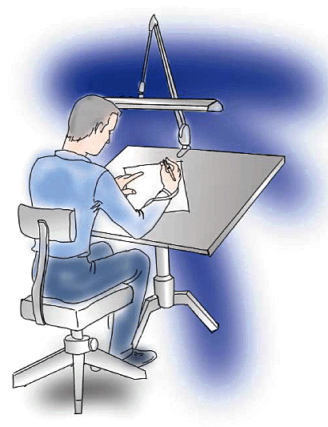
10 Steps for Designing Education
Reasons Why Changes are Needed
Desired State
Current State
Educational Gap
Learning Objectives
Educational Content
Method of Teaching
Measure Short-Term Effects
Evaluate Long-Term Effects
Reassess

Slide 3
10 Steps for Designing Education
Reasons Why Changes are Needed (explain/convince)
Desired State
Current State
Educational Gap
Learning Objectives
Educational Content
Method of Teaching
Measure Short-Term Effects
Evaluate Long-Term Effects
Reassess
Notes:
The most important item is convincing the student the reasons why changes are needed

Slide 4
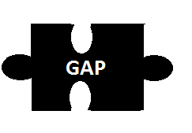
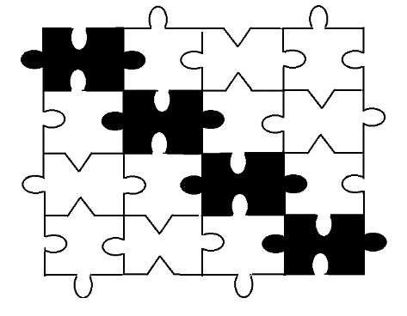
10 Steps for Designing Education
Reasons Why Changes are Needed (explain/convince)
Desired State
Current State
Educational Gap
Learning Objectives
Educational Content
Method of Teaching
Measure Short-Term Effects
Evaluate Long-Term Effects
Reassess
}
= current → desired
Desired
Current
Notes:
Desired state where we want to be
Current state is where we are today
The difference is the gap (education)
but there maybe many gaps which may include education of new ideas, using new equipment, new protocols, new documentation

Slide 5
10 Steps for Designing Education
Reasons Why Changes are Needed
Desired State
Current State
Educational Gap
Learning Objectives (could be many)
Educational Content (detailed outline with supporting evidence)
Method of Teaching (online, didactic, skills, sim, etc.)
Measure Short-Term Effects (written test, simulations, etc.)
Evaluate Long-Term Effects (performance, patient outcomes, etc.)
Reassess (repeat steps 1-10 until desired state achieved)
Notes:
The educational gap will then determine the needed learning objectives
If several gaps then may need many objectives

Slide 6
1. Reasons Why Changes are Needed
Improve patient outcomes*
Improve knowledge#
Improve patient comfort
Improve expertise
Improve data collected
Increase compliance
Increase reimbursement
Why do
we need to
learn this?
* should be the number one goal
# based on latest evidenced based medicine

Slide 7
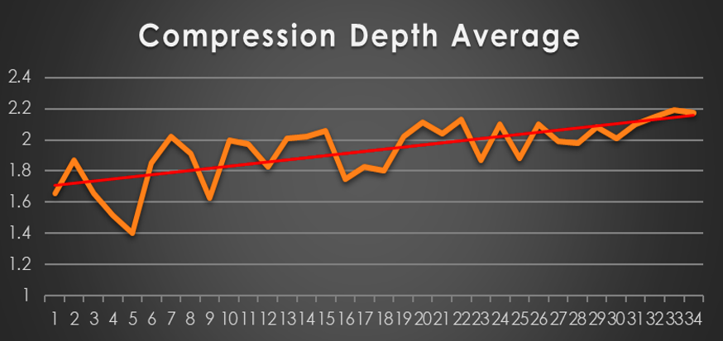
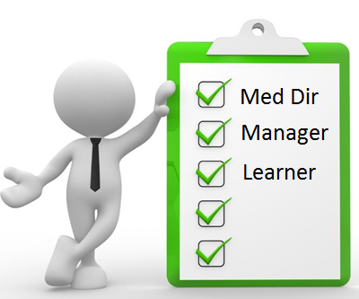
1. Reasons Why Changes are Needed
Input from stakeholders (medical directors, managers, learners)
Performance improvement projects/quality studies
Evaluations from previous courses
Survey data
Discussions
Observations
Trends/ideas
Equipment
Laws/regulations
Notes:
Input from stake holders and performance/quality projects should be based on evidenced based medicine with the goal of improving pt care
Currently we are not pushing hard enough with current compression depth of only 1.6 inches
The goal is to reach the 2-2.5 inch mark

Slide 8

2. Desired State
Define the desired state
  Determine what should we be doing tomorrow based on the latest evidenced based medicine
  Review why we are NOT doing it
  Do we need new protocols/guidelines?
  Do we need new laws/rules?
  Do we need new equipment?
  Do we need new documentation/
  reimbursement?
ETCO2
ETCO2
Notes:
A good example is waveform capnography
Are you using it to its full potential….ETI, COPD v. CHF, Sepsis
Have you updated your protocols
Have you updated your equipment , documentation

Slide 9
3. Current State
Define the current state
  Determine what we are doing today
  Review why we are doing it that way
  Review current protocols/guidelines
  Review old laws/rules
  Examine old equipment
  Review current reimbursement
  Review current documentation/methods of recording
  Review old science that had been published

Slide 10
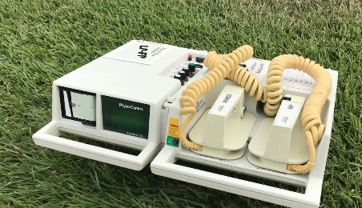
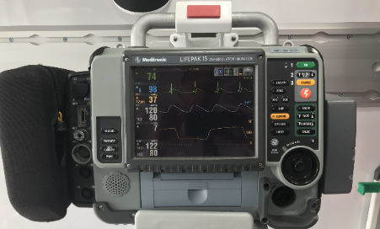
4. Educational Gap
Define the “Gap”
What’s the difference (desired versus current state)
  New vs. old science
  New vs. old protocols/guidelines
  New vs. old laws/rules
  New vs. old equipment
  New vs. old documentation /reimbursement
ETCO2
ETCO2
Notes:
In the case of waveform capnography
There is new science, new protocols, new equipment, new documentation

Slide 11
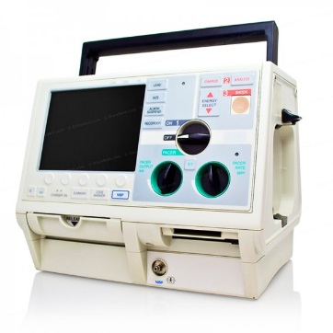
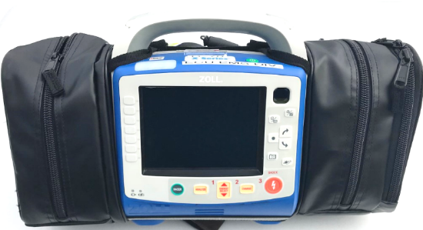
4. Educational Gap
Define the “Gap”
What’s the difference (desired - current state)
  Educational needs of new science
  Educational needs of protocols/guidelines
  Educational needs of new laws/rules
  Educational needs of new equipment
  Educational needs of new documentation/
  reimbursement
Notes:
Need to determine the educational gap associated with the new science, new protocols, new laws, new equipment, new documentation.

Slide 12
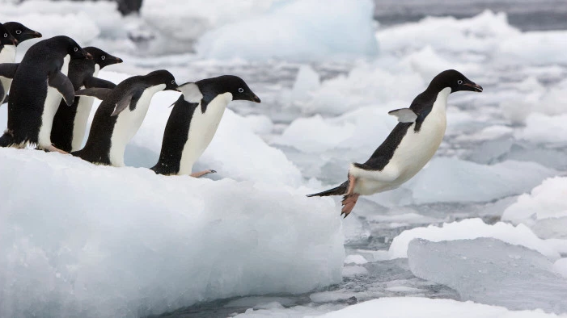
3. What is the desired status? AKA the “gap”
- Knowledge of new information -
Notes:
What do you need to cross the gap
Sometimes it is a big jump / hurdle

Slide 13
“Gap” in knowledge as result of:
Change in practice
Problems with practice
Performance
Competence
Patient outcomes
New science/trends/treatments/laws
Opportunity for improvement
(new knowledge)
Notes:
Sometimes the change in practice requires more than one gap in education/knowledge
And may include educational gaps due to new equipment, new protocols, new documentation etc
Goal ultimate goals is better performance, competence and most importantly better pt outcomes

Slide 14
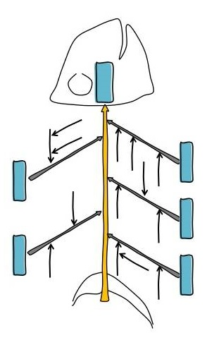
5. Learning Objectives
Who (EMT, A, P, or all)
What it is
What if
What could
Why to do it
Why not
When to do it
When not
How to
How much
Taps/tricks/risks
Legal issues
Documentation
What to watch for
Other issues?
The bigger picture!
If unsure - make a fishbone diagram to look at the entire concept.
Education can focus on all, or just parts of the concept.
Notes:
Who What Why When How
The big picture

Slide 15
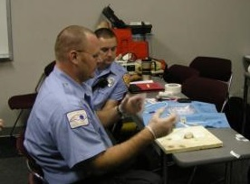
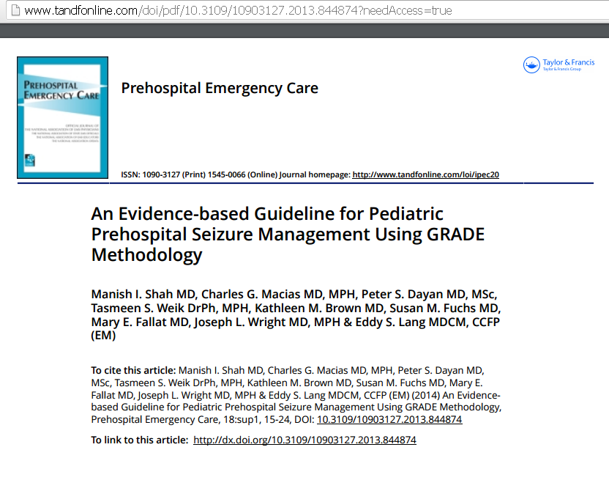
6. Educational Content
Based on:
Learning objectives
Desired outcome(s)
Student availability
Method of teaching
Method of measuring success
Include references /
resources with outline =
the evidence-based medicine
Notes:
Educational content should be detailed and include:

Slide 16
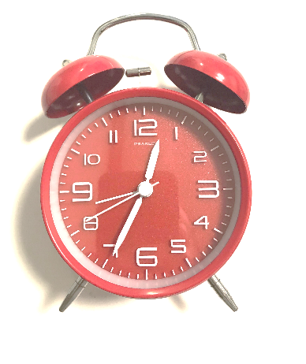
7. Method of Teaching
Who & what methods are best in order to optimize education
Time allowed
Necessity
Resources
Newness
Complexity
Unlearning/relearning
Frequency of doing it
Retention issues
Who teaches-MD or medic
On-line and/or live
Flipped classroom
Didactic and/or skills
Combo = lecture & skills
Scenario and/or sim-based
Testing
Curriculum matching
Best practices, etc

Slide 17
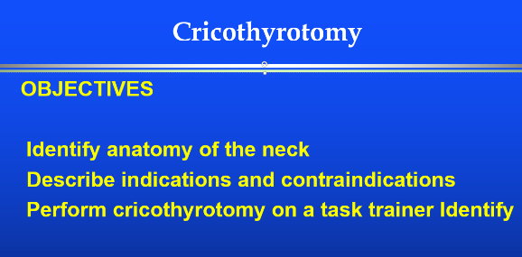
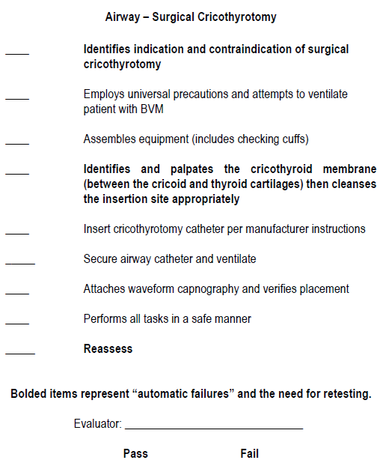
Best Practices in EMS
Curriculum Matching
Before rollout be sure that
  Your educational content matches with
  the educational learning objectives
  Your testing matches with your educational content
  Your testing matches with the educational learning objectives

Slide 18
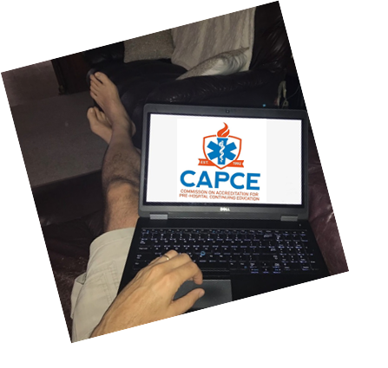
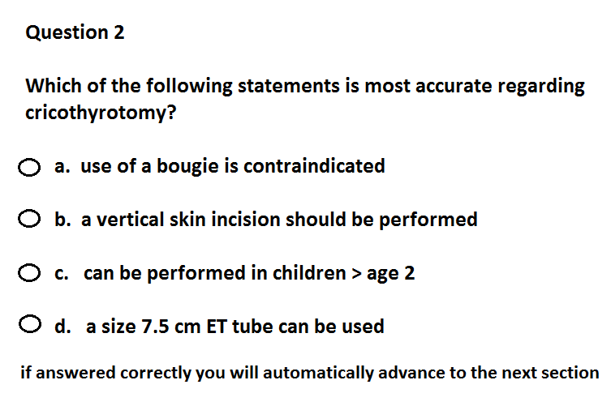
Best Practices in EMS
How technology is changing the way we deliver continuing education
  Online (distributive learning) options also include virtual lead training, video, etc.
  Gated testing can’t assess the test until educational module is complete
  Integrated testing requires the student to answer questions throughout the educational module in order to continue

Slide 19
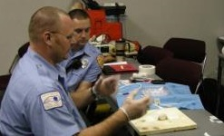
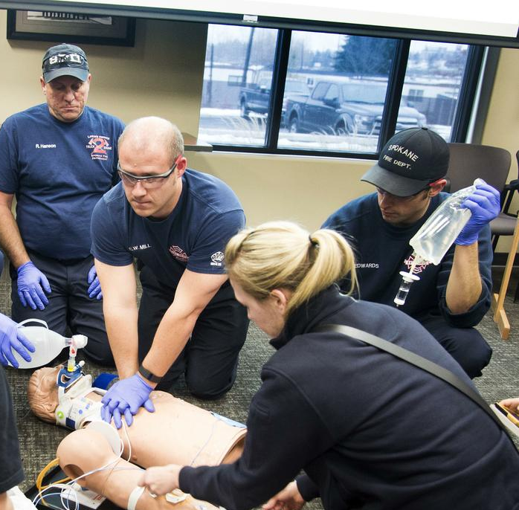
8. Measuring Short-Term Effects
Identify methods and “passing score”
Attestation
Written Test/Quiz
Skills testing (task trainer)
Scenario and/or Simulation based
Observation in the field
Chart Review

Slide 20
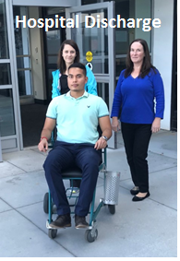
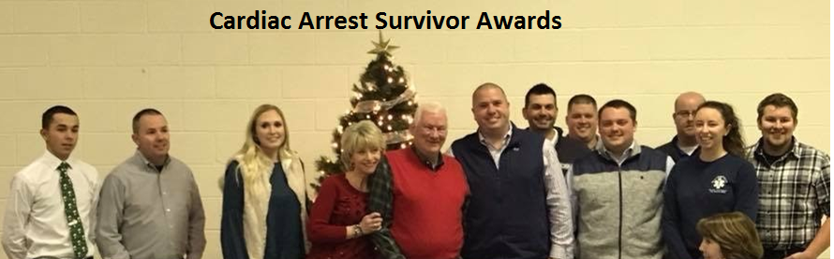

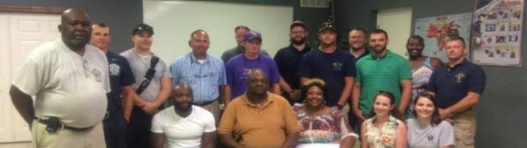
9. Evaluating Long-Term Effects
Identify methods and “passing score”
Attestation
Written Test/Quiz
Skills testing (task trainer)
Scenario and/or Simulation based
Observation in field
Chart Review
Complications
Performance Measures
Patient Outcomes
Notes:
Long term goals may require revaluation of short term effects
but more importantly need to include Complications, Performance Measures, Patient Outcomes

Slide 21

10. Reassess
Did the “gap” get filled?
Did the education lead to change in practice?
Is the skill being maintained?
Determine time to recheck based on frequency of performing the activity
Ask - Are there other components to teach?
Repeat steps 1-10 until desired state achieved
Notes:
Did the gap or gaps get filled
Reassessment is the key to be sure you have not only achieved your goal but maintained it over time

Slide 22
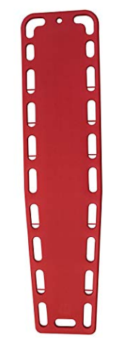
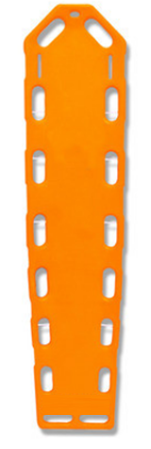


10 Steps for Designing Education
EXAMPLE - Spinal Motion Restriction
Notes:
Lets go over an example of spinal motion restriction,
previously AKA spinal immobilization

Slide 23
10 Steps for Designing Education
EXAMPLE - Spinal Motion Restriction
1. Reasons Why Changes are Needed
Research does not support spinal immobilization, harm > good
2. Desired State
Use backboard to facilitate transport, not spinal immobilization
3. Current State
Using backboard for spinal immobilization on every MVC / fall
4. Educational Gap
Not knowing harm; not knowing there is a lack of benefit
5. Learning Objectives
Describe harm associated with use of backboards, limit their use

Slide 24
10 Steps for Designing Education
EXAMPLE - Spinal Motion Restriction
6. Educational Content
Research (decubitus ulcers, sepsis, pain, unnecessary x-rays)
7. Method of Teaching
Online and didactic (no need for skills)
8. Measure Short-term Effects
Written test, complaints from ED staff, documentation issues
9. Evaluate Long-term Effects
Decreased use backboards, decubitus, x-rays, complaints from ED
10. Reassess
Repeat steps 1-10 until EMS stops routine use of backboards

Slide 25
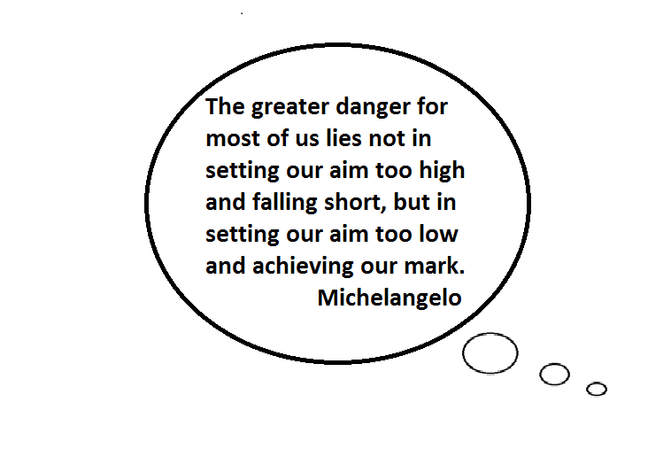
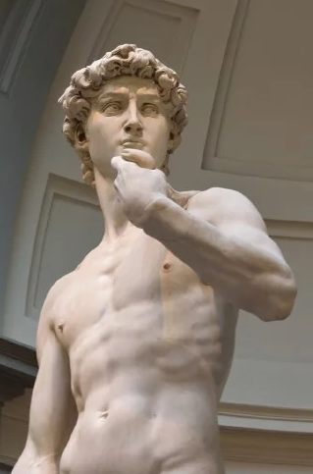
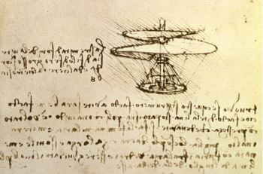
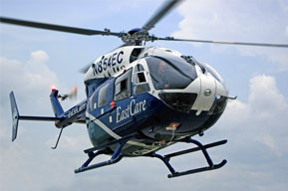
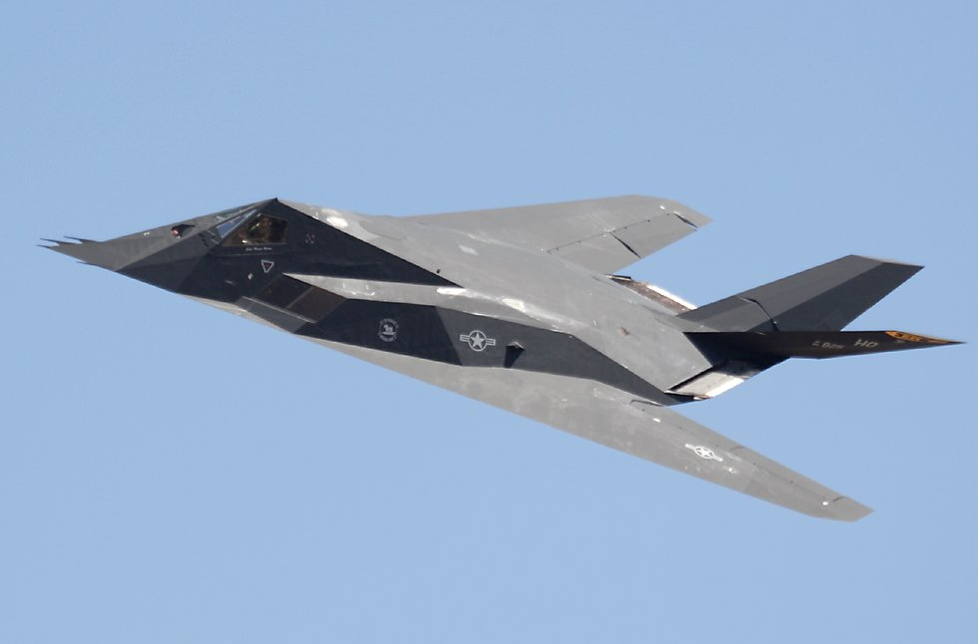
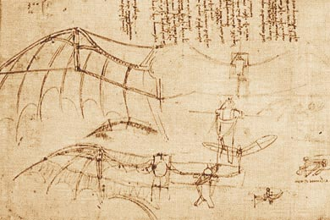
?

Slide 26
References
Curriculum Matching. EMS World 2017;46(5):44-45.
Best Practices in CE. EMS World 2015;44(6):28-31.
Spinal Motion Restriction in the Trauma Patient. Prehospital Emergency Care 2018;22(6):659-661
Resources
https://www.cecbems.org/
https://www.cecbems.org/docs/CAPCE%20Best%20Practices%20Model%203%20[433].pdf

